Slide 1
A Gentle Tutorial On LSTM - From Algorithm to Application
Weihao Li

Slide 2
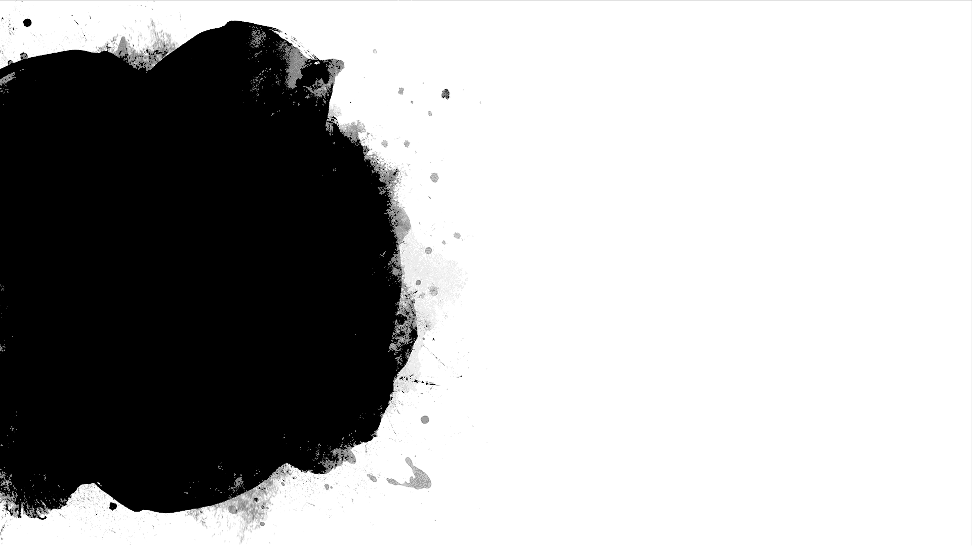
Outline
PowerPoint:
Background of LSTM
Step by step of LSTM
Drawback and variants/improvements
Jupiter notebook:
Forward and backward algorithm details(formula + code)
Details on initialization, gradient clipping and stochastics gradient descend(Ideas + code)
Q&A
Notes: LSTM parts are based on Colah’s blog

Slide 3
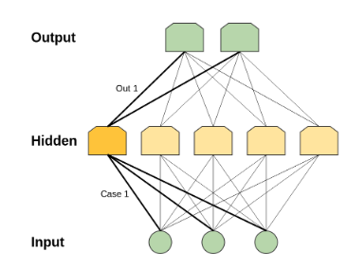
Normal Neural Networks
Traditional neural networks try to learn the mapping between input and output concurrently.
What if the input at time t have impact to the output at time t+1?
Notes:
Shifted the input and make new input_t = [input _t-1, input _t]
Sure, but there will be a huge inputs size if we want to look far back

Slide 4
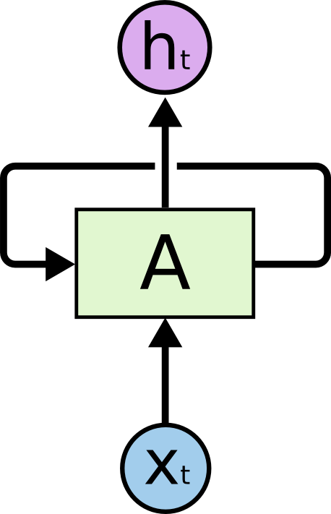
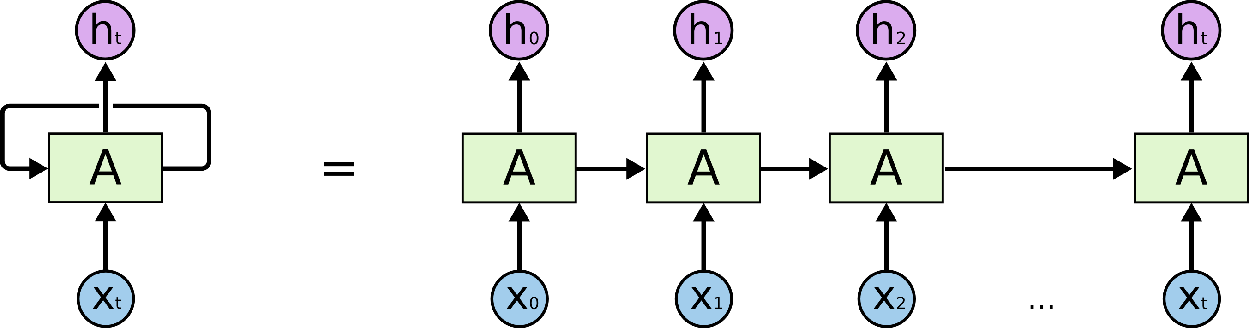
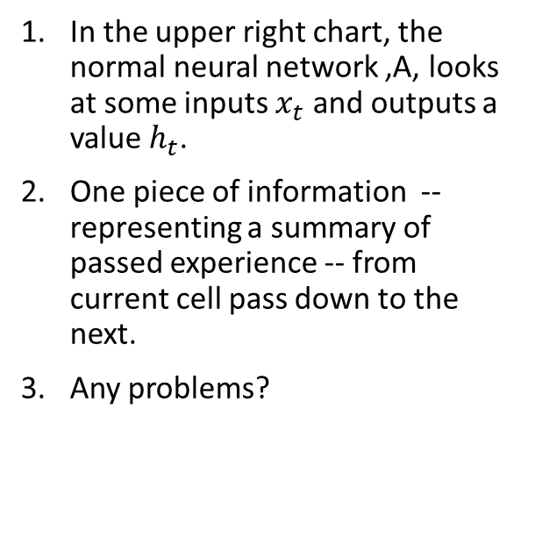
Recurrent Neural Networks
In the upper right chart, the normal neural network ,A, looks at some inputs $x_{t}$ and outputs a value $h_{t}$.
One piece of information -- representing a summary of passed experience -- from current cell pass down to the next.
Any problems?

Slide 5
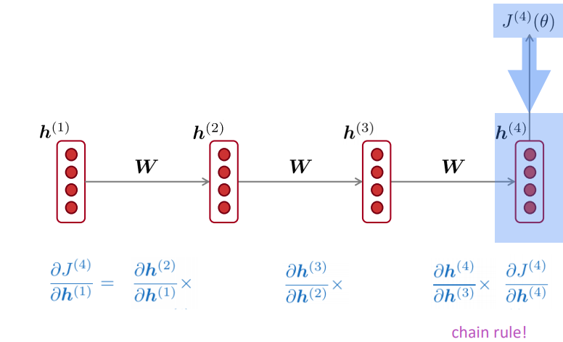
Backpropagation and gradient vanishing
When training the neural network, we try to minimize the error by adjusting the weight W(more in Jupiter notebook).
The gradient measures impacts of change in weight on the Loss function

Slide 6
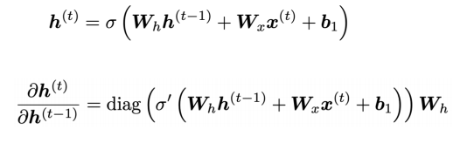
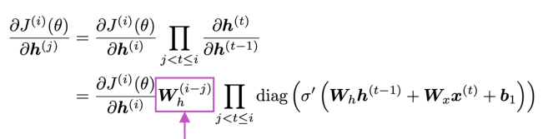
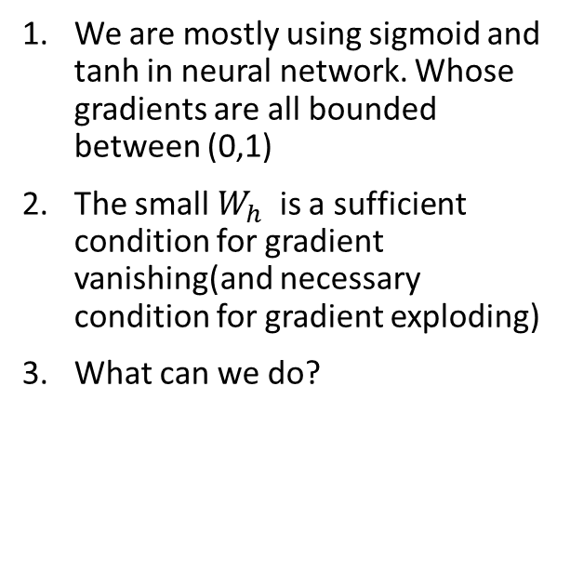
Backpropagation and gradient vanishing(cont.)
We are mostly using sigmoid and tanh in neural network. Whose gradients are all bounded between (0,1)
The small $W_{h}$ is a sufficient condition for gradient vanishing(and necessary condition for gradient exploding)
What can we do?

Slide 7
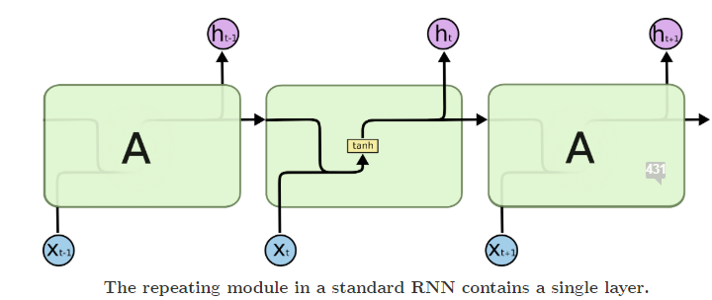
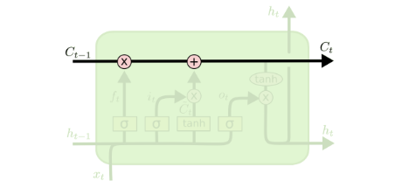
From RNN to LSTM
In normal RNN, all information pass down has to go through the activation function, which introduces that problem
LSTM rescues this problem by introducing a more direct path C.
With this idea ,some information processing steps, we have the classical LSTM

Slide 8
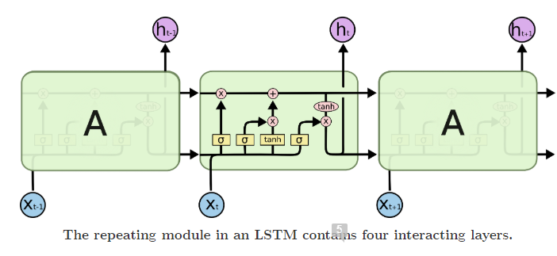
LSTM - Overview
Forget gate: decide what to forget/remember
Input gate: determine what new things to learn and retained
Output gate: determine what would be the output and new hidden layer

Slide 9
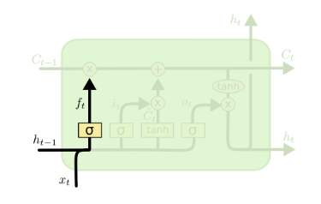

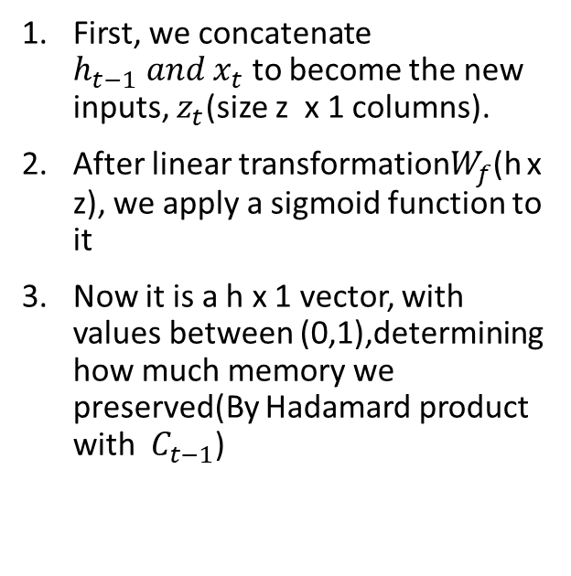
LSTM – Forget gate
First, we concatenate $h_{t−1} and x_{t}$ to become the new inputs, $z_{t}$(size z x 1 columns).
After linear transformation$W_{f}$(h x z), we apply a sigmoid function to it
Now it is a h x 1 vector, with values between (0,1),determining how much memory we preserved(By Hadamard product with $C_{t−1}$)

Slide 10
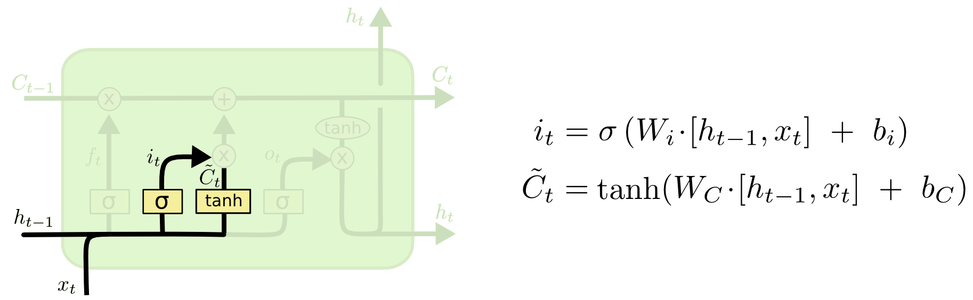

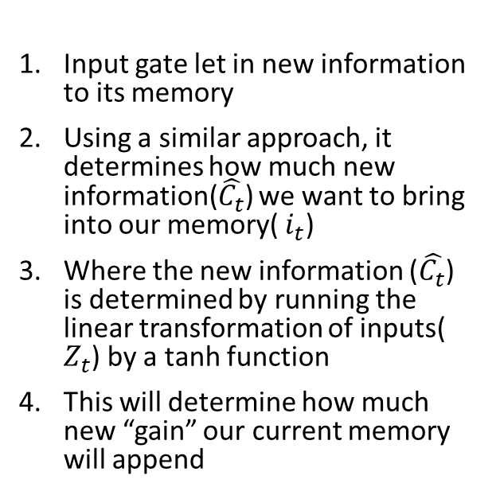
LSTM – Input gate
Input gate let in new information to its memory
Using a similar approach, it determines how much new information($\hat{C_{t}}$) we want to bring into our memory( $i_{t}$)
Where the new information ($\hat{C_{t}}$) is determined by running the linear transformation of inputs( $Z_{t}$) by a tanh function
This will determine how much new “gain” our current memory will append

Slide 11
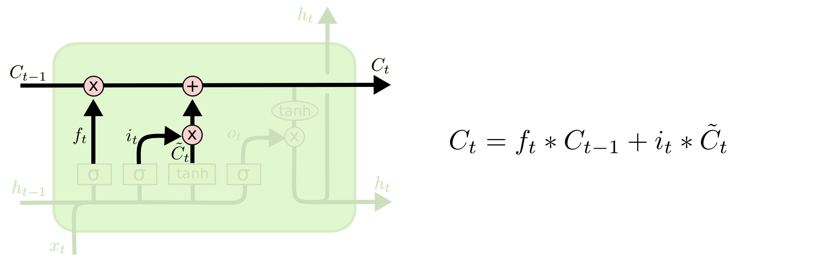
LSTM – Passing memory
After forgetting and appending new memory, we are now passing our memory into next stage
New memory = passed memory x forget rate + new knowledge x retained rate

Slide 12
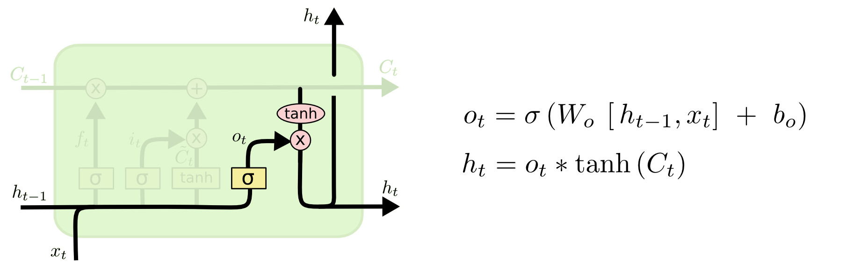
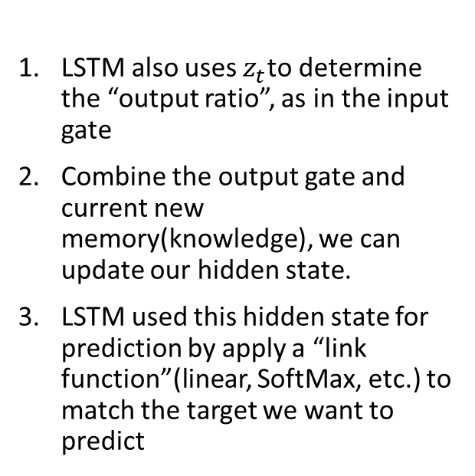

LSTM – Output gate
LSTM also uses $z_{t}$to determine the “output ratio”, as in the input gate
Combine the output gate and current new memory(knowledge), we can update our hidden state.
LSTM used this hidden state for prediction by apply a “link function”(linear, SoftMax, etc.) to match the target we want to predict
$$\hat{y_{t}}=Link(W_{v} h_{t})$$

Slide 13
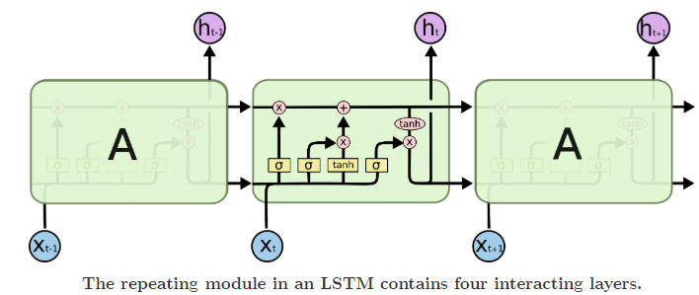
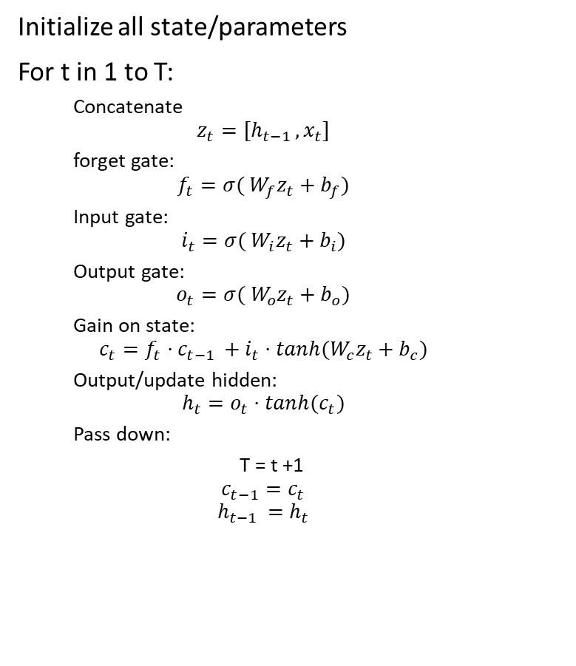
LSTM – algorithm forward
Initialize all state/parameters
For t in 1 to T:
Concatenate
$$z_{t}=[h_{t−1 },x_{t}]$$
forget gate:
$$f_{t}=σ( W_{f}z_{t}+b_{f})$$
Input gate:
$$i_{t}=σ( W_{i}z_{t}+b_{i})$$
Output gate:
$$o_{t}=σ( W_{o}z_{t}+b_{o})$$
Gain on state:
$$c_{t}=f_{t}⋅c_{t−1 }+i_{t}⋅tanh(W_{c}z_{t}+b_{c})$$
Output/update hidden:
$$h_{t}=o_{t}⋅tanh(c_{t})$$
Pass down:
T = t +1
$$c_{t−1}=c_{t}$$
$$h_{t−1 }=h_{t}$$

Slide 14

























LSTM – algorithm backward
$$dC_{t−1}^{′}$$
$$dC_{t}$$
$$dC_{t}^{′}$$
$$C_{t−1}$$
$$C_{t}$$
$$f_{t}$$
$$df_{t}$$
$$i_{t}$$
$$di_{t}$$
$${\overline{C}}_{t}$$
$$d{\overline{C}}_{t}$$
$$o_{t}$$
$$do_{t}$$
$$dh_{t}$$
$$dh_{t−1}^{′}$$
$$dz_{t}$$
$$d{h′}_{t}$$
$$h_{t−1}$$
$$h_{t}$$
$${ z}_{t}$$
$$dx_{t}$$
$$W_{v}$$
$$dv_{t}$$
$$v_{t}$$

Slide 15
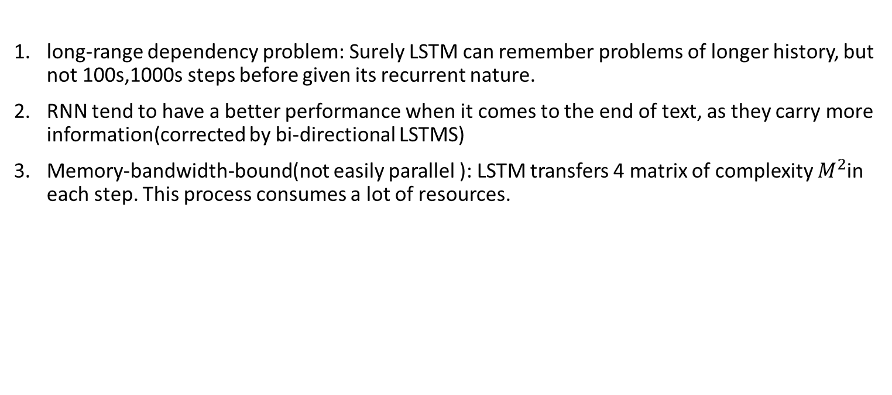
Disadvantage of LSTM
long-range dependency problem: Surely LSTM can remember problems of longer history, but not 100s,1000s steps before given its recurrent nature.
RNN tend to have a better performance when it comes to the end of text, as they carry more information(corrected by bi-directional LSTMS)
Memory-bandwidth-bound(not easily parallel ): LSTM transfers 4 matrix of complexity $M^{2}$in each step. This process consumes a lot of resources.

Slide 16
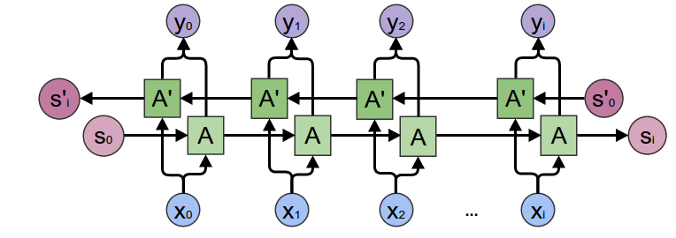
Improvements: Bi-directions
This solved the feed forward LSTM problems by looking into future states, combine information from both directions to train the network

Slide 17
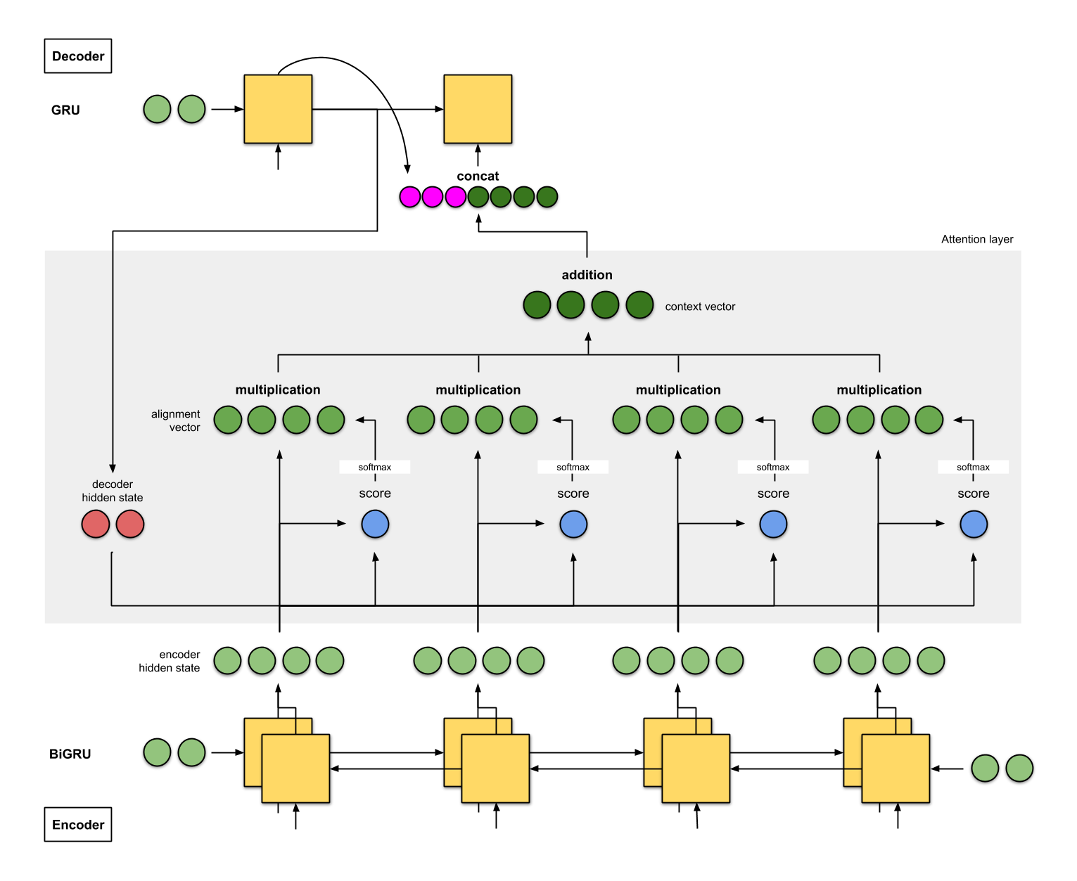
Improvements: Attention
Encoder decoder with Attentions:
In an encoder-decoder network. We use all hidden state from the encoder as input for the decoder. But we want to assigns different weights(attentions) to these hidden states.

Slide 18
Conclusions
RNN provides a better way to summarize pass information, but suffers vanishing gradient problems
LSTM solves this problem by adding a cell states to preserves memories
LSTM also suffers from several problems, which could be corrected attentions/bi-direction LSTMs
Deep learning is fun!

Slide 19
Sources：
Pictures of Attentions network
https://towardsdatascience.com/attn-illustrated-attention-5ec4ad276ee3
Pictures of LSTMS
http://colah.github.io/posts/2015-08-Understanding-LSTMs/
Vanishing gradients:
https://web.stanford.edu/class/cs224n/slides/cs224n-2019-lecture07-fancy-rnn.pdf
Razvan Pascanu, Tomas Mikolov, and Yoshua Bengio. 2013. On the difficulty of training recurrent neural networks. In Proceedings of the 30th International Conference on International Conference on Machine Learning - Volume 28 (ICML’13). JMLR.org, III–1310–III–1318.
Tutorial on building LSTM: https://blog.varunajayasiri.com/numpy_lstm.html

